Slide 1
Anti-NMDA receptor Encephalitis

Slide 2
Overview
Type of Paraneoplastic encephalitis, immune-mediated encephaltis
Disturbance of memory, behavior, cognition, seizure can result from autoimmune encephalitis, paraneoplastic manifestation of a neoplasm.
Autoimmunity can affect behavior, and particularly that antibodies to heteromers containing the NR2B and NR2A subunits of the NMDAR may alter emotion, memory, and consciousness.
Diamond B et al. Immunity and acquired alterations in cognition and emotion: lessons from SLE. Adv Immunol 2006;89:289–320

Slide 3
OVERVIEW
Frequency : Unclear
Several features
Involvement of relatively young women. (20~50 decades, median 23, 25.8)
Unusual presentation with prominent psyciatric manifestations.
Normal of atypical MRI findings. (75% of cases consist of mild, transient T2 of FLAIR abnormalities outside the medial temporal lobes, sometimes with cortical enhancement)
Benign appearance of the ovarian tumors. (About 59% of the patients)
High prevalence of prodromal viral-like symptoms (part of early immune reaction)
Josep D et al. Paraneoplastic Anti–N-methyl-D-aspartate Receptor Encephalitis
Associated with Ovarian Teratoma Ann Neurol. 2007 January ; 61(1): 25–36.

Slide 4
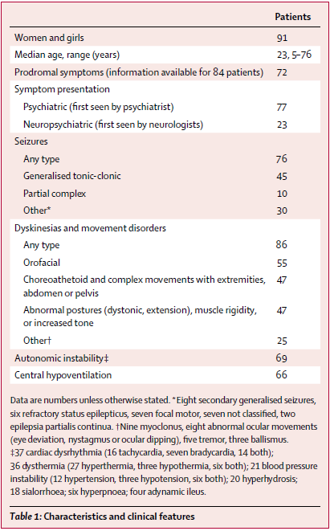
Josep D et al. Anti-NMDA-receptor encephalitis: case series and analysis of the effects of antibodies. Lancet Neurol. 2008;7:1091-98.

Slide 5
Clinical manifestation
Psychiatric symptoms
Patients are often admitted to psychiatric centers.
Confusion, restless, agitation, paranoid or delusion thoughts, sometimes alternating with quiet staring and dystonic or catatonic postures.
Seizures & decrease level of consciousness, autonomic instability, dyskinesia
May need antiepileptic drugs, sedation, mechanical ventilation
Limited recovery of consciousness and spontaneous respiration with attempt to decrease the sedation and wean from ventilation.
Central hypoventilation – independent of dyskinesia
Josep D et al. Paraneoplastic Anti–N-methyl-D-aspartate Receptor Encephalitis
Associated with Ovarian Teratoma Ann Neurol. 2007 January ; 61(1): 25–36.

Slide 6
Clinical manifestation
Prodromal phase
Nonspecific cold or viral like symptoms (fever, fatigue or headache) and, after a mean peroid of 5 days, developed psychobehavioral symptoms.
T. Lizuki et al. Anti-NMDA receptor encephalitis in Japan: Long-term outcome
without tumor removal Neurology. 2008 February 12; 70(7): 504–511

Slide 7
Clinical manifestation
Psychotic phase: Within 2 weeks (mean 6.8 days) of developing symptoms
Emotional disturbance (apathy, lack of emotion, depression, loneliness, fear)
Cognitive decline (difficulty in using a cellular phone or passing through an automatic ticket gate)
Prominent schizophrenia like symptoms (disorganized thinking, compulsive ideation, delusions, hallucinations, and loss of self-awareness)
Amnesia (not prominent at onset)
Strange behavior : staring at their reflection in a mirror with an odd smile
T. Lizuki et al. Anti-NMDA receptor encephalitis in Japan: Long-term outcome
without tumor removal Neurology. 2008 February 12; 70(7): 504–511

Slide 8
Clinical manifestation
Unresponsive phase
Catalepsy-like symptoms (Mute, akinetic, unresponsive to verbal commands while keeping their eye open)
Bizarre and inappropriate smiling.
Athetoid dystonic postures, echo phenomenon (mimicking the examiner’s movement)
Normal Brainstem reflexes, but no eye movement with visual threat
T. Lizuki et al. Anti-NMDA receptor encephalitis in Japan: Long-term outcome
without tumor removal Neurology. 2008 February 12; 70(7): 504–511

Slide 9
Clinical manifestation
Hyperkinetic phase
All patients gradually developed orolingual dyskinesias such as lip licking or chewing, and athetoid dystonic postures of the fingers.
Intractable bizarre orofacial-limb dyskinesias
Sustained jaw movements, forceful clenching of the teeth, jaw-opening dystonia, grimacing, intermittent ocular deviation or disconjugation, athetoid dystonic movements, and dancinglike movements of the arms.
Varied in speed, distribution, and motor pattern (like psychogenic movement disorder)
All patients had symptoms of autonomic instability
Labile blood pressure, bradycardia or tachycardia, hyperthermia, and diaphoresis.
T. Lizuki et al. Anti-NMDA receptor encephalitis in Japan: Long-term outcome
without tumor removal Neurology. 2008 February 12; 70(7): 504–511

Slide 10
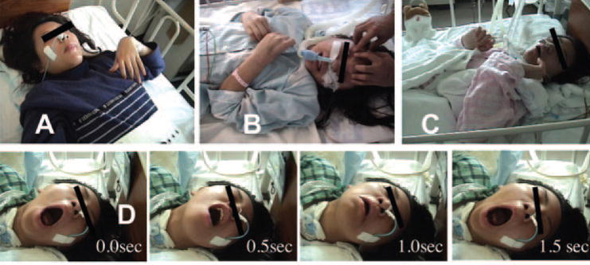

Slide 11
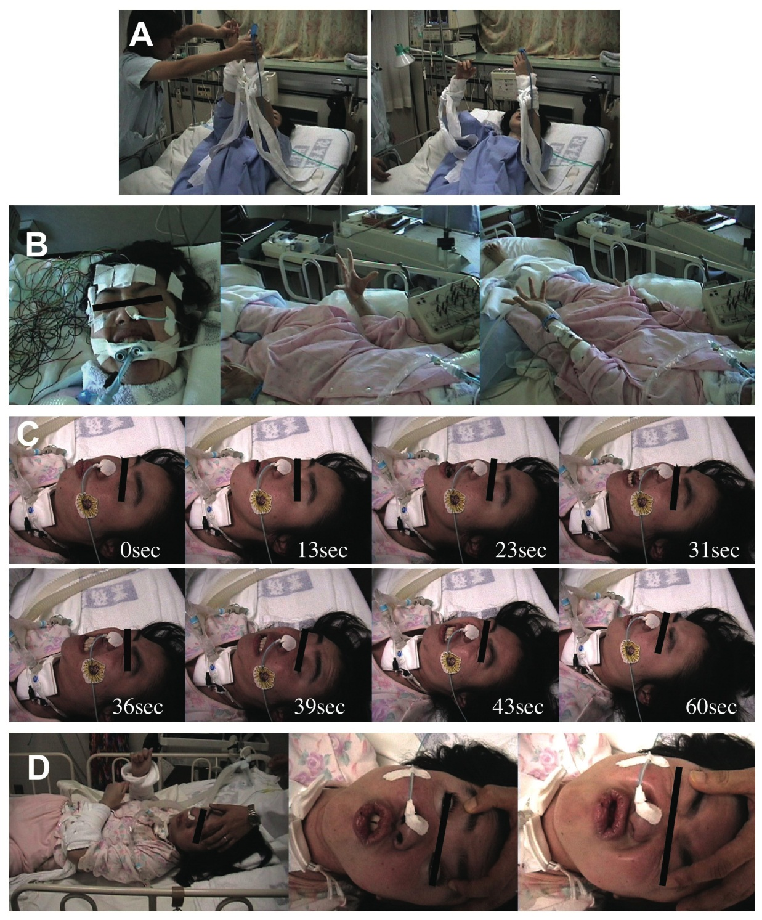

Slide 12
Clinical manifestation
Gradual recovery phase
Typically slow, symptoms may relapse, especially in patient with undetected or recurrent tumors and patients with no associated tumors.
Duration of the hospital stay: 2~14 month (mean 7 months)
Spontaneous progressive improvement until recovery
Characteristic features of patients who recovered from encephalitis
Persisting amnesia of the entire process
Compatible with disruption of the mechanism of synaptic plasticity – thought to underlie learning and memory
Josep D et al. Anti-NMDA-receptor encephalitis: case series and analysis of the effects of antibodies. Lancet Neurol. 2008;7:1091-98.
T. Lizuki et al. Anti-NMDA receptor encephalitis in Japan: Long-term outcome
without tumor removal Neurology. 2008 February 12; 70(7): 504–511

Slide 13
Mechanism & Pathophysiology
Mechanism of triggering the immune response remain unclear
Postulation : expression of NR2 subunits by nervous tissue contained in the teratomas contributes to break immune tolerance.
Prodromal viral like illness : could play additional roles in the initiation of the immune response (perhapse a genetic disposition).
Antibody breach the blood-brain barrier
Infection or hypertension significantly enhanced antibody enterance to CNS.
Amygdala and hippocampus: hightest level of NR2B, NR2A, also regions where the blood-brain barrier is most vulnerable to these mechanism.
Josep D et al. Paraneoplastic Anti–N-methyl-D-aspartate Receptor Encephalitis
Associated with Ovarian Teratoma Ann Neurol. 2007 January ; 61(1): 25–36.
Notes:
환자들은 Hypertension 및 Sympathetic overactivity 가 자주 발생하였다. 이는 BBB로의 leakiness를 늘어나게 하는 요인이 된 것으로 보인다.

Slide 14
NMDAR
All patients has antibody to NMDARs containing NR2B, and at a lesser degree, the NR2A subunits. Anti-NMDAR receptor encephalitis associated with antibodies against the NR1 subunit of the receptor.
NMDAR : heteromers of NR1(bind glycin) and NR2 (bind glutamate) subunits.
In adults : NR2A is found in most brain regions, NR2B in the hippocampus and forebrain, NR2C in cerebellum, NR2D is limited subsets of neurons.
Antibodies readily access cell-surface epitopes of live neuron and react only with HEK293 cells expressing functional receptors (heteromers of NR1/NR2B or NR1/NR2A).
Josep D et al. Paraneoplastic Anti–N-methyl-D-aspartate Receptor Encephalitis
Associated with Ovarian Teratoma Ann Neurol. 2007 January ; 61(1): 25–36.
Notes:
NR2 : 4개의 subunit을 가지며(A-D) extracellular domain은 50~70%의 일치율을 보인다. (NR2B는 NR2A와 70% 동일, NR2C 및 NR2D와 55~58% 동일함)
태어날 때 NR2B가 가장 높은 농도를 보이지만 이후 점차 줄어들게 되며, 이와 연관하여 NR2A와 NR2C의 농도가 늘어난다. 성인에서는 NR2A가 가장 많은 농도를 차지한다.
NR1은 뇌 전반적으로 분포되어 있다. With maturity, many NR1/NR2B receptors become largely extrasynaptic in hippocampal neurons and NR1/NR2A/NR2B becomes the major synaptic receptors in the hippocampus and forebrain.

Slide 15
NMDAR
Critical role of NMDAR
Synaptic transmission, remodeling, dendritic sprouting, hippocampal long-term potentiation, one paradigm of memory formation and learning.
Also the major mediator of excitotoxicity, dysfunction has been associated with schizophrenia and epilepsy, several type of dementia.
Drug interacting with NMDAR may result in paranoia, hallucination and dyskinesia
Low activity of NMDAR produces symptoms of schizophrenia.
Josep D et al. Paraneoplastic Anti–N-methyl-D-aspartate Receptor Encephalitis
Associated with Ovarian Teratoma Ann Neurol. 2007 January ; 61(1): 25–36.

Slide 16
Antibody Titer
Correlation between antibody titers and neurological outcome and by the decrease in number of postsynaptic clusters of NMDA receptors caused by patient’s antibodies.
Reversed by removing the antibodies from the cultures, explaining the potential reversibility of patient’s symptoms.
Josep D et al. Anti-NMDA-receptor encephalitis: case series and analysis of the effects of antibodies. Lancet Neurol. 2008;7:1091-98.

Slide 17
Diagnosis
Characteristic clinical features – psychotic symptoms, pelvic tumor…
Antibodies to NR1/NR2B heteromers of the NMDAR in the serum and CSF
Diagnostic Brain Imaging
MRI : Less predictable (about 55% has abnormality)
SPECT, FDG-PET
Others : CSF pleocytosis, EEG…
EEG: diffuse delta activity without paroxysmal discharges (usually)
Josep D et al. Paraneoplastic Anti–N-methyl-D-aspartate Receptor Encephalitis
Associated with Ovarian Teratoma Ann Neurol. 2007 January ; 61(1): 25–36.
Notes:
Orofacial-limb dyskinesias did not have an epileptic correlate during extensive EEG monitoring.

Slide 18
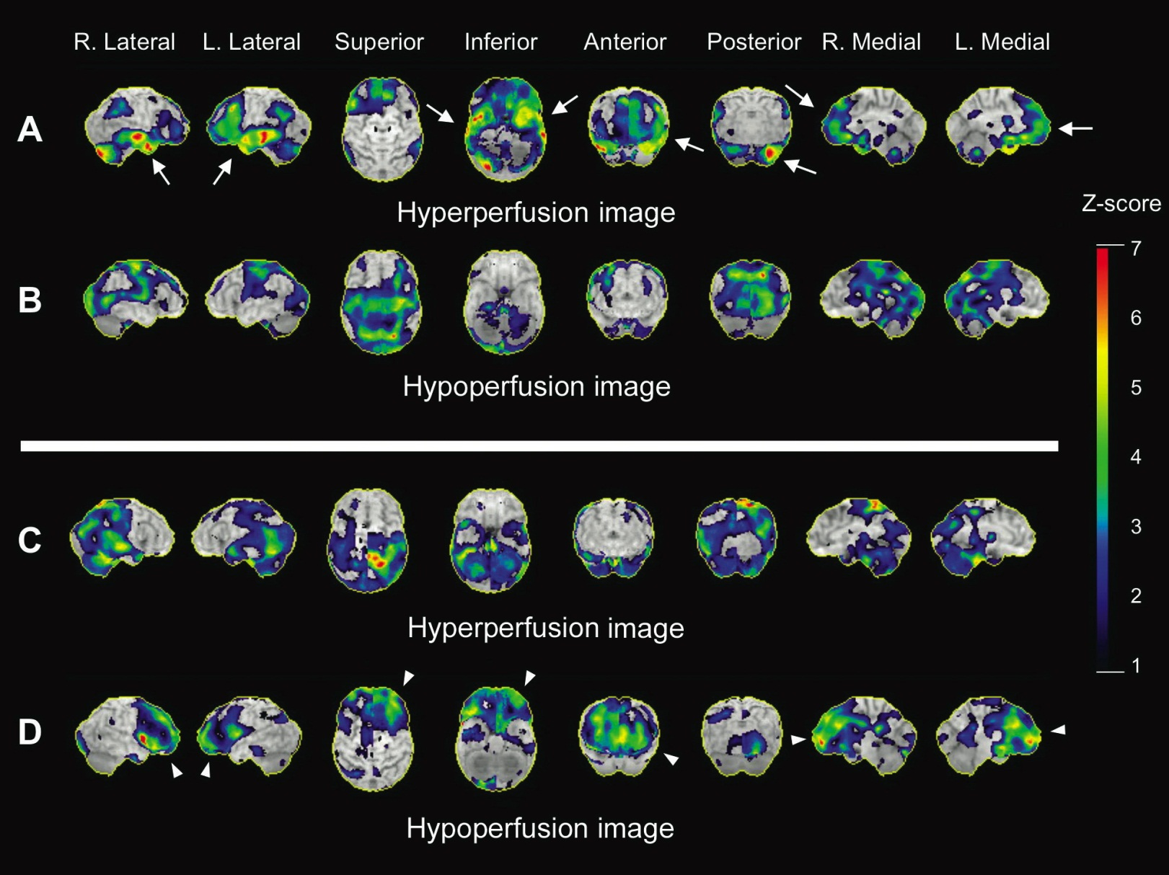
A: frontotemporal hyperperfusion at the early stage.
B: frontotemporal atrophy during convalescence stage
D: prefrontal hypoperfusion during convalescence
No significant focal changes during the acute stage of the disease.
In some patients showed abnormality on 3D SSP.
SPECT
T. Lizuki et al. Anti-NMDA receptor encephalitis in Japan: Long-term outcome
without tumor removal Neurology. 2008 February 12; 70(7): 504–511
Notes:
SSP : stereotactic surface projection

Slide 19
In some patient, symmetric accumulation of the tracer in the primary motor, premotor, and supplementary motor areas, but not in the basal ganglia, during the time that the patient had severe orofacial dyskinesias.
However, no abnormal FDG uptake was seen during convalescence
FDG-PET
T. Lizuki et al. Anti-NMDA receptor encephalitis in Japan: Long-term outcome
without tumor removal Neurology. 2008 February 12; 70(7): 504–511

Slide 20
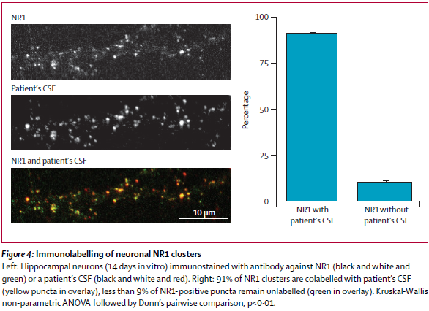
Josep D et al. Anti-NMDA-receptor encephalitis: case series and analysis of the effects of antibodies. Lancet Neurol. 2008;7:1091-98.

Slide 21
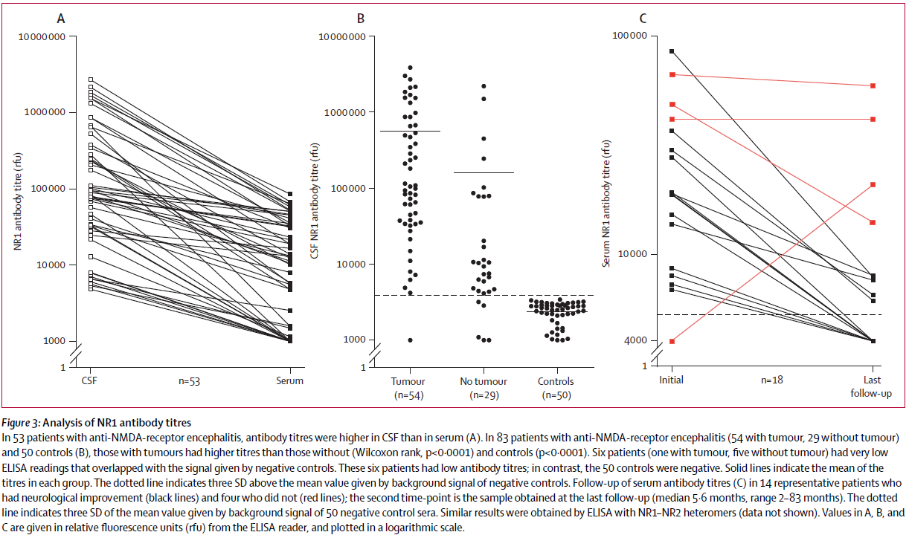
Josep D et al. Anti-NMDA-receptor encephalitis: case series and analysis of the effects of antibodies. Lancet Neurol. 2008;7:1091-98.
Notes:
(A) Serum에 비해 CSF에서 NR1 antibody titer가 높았다. (B) Control 군에 비해서 Tumor를 가진 군에서 Antibody titer가 높았다. (C) 증상에 호전이 있었던 사람은 titer가 감소하는 양상을 보였지만 그렇지 않은 사람은 큰 변화가 없거나 늘어나는 양상을 보였다.

Slide 22
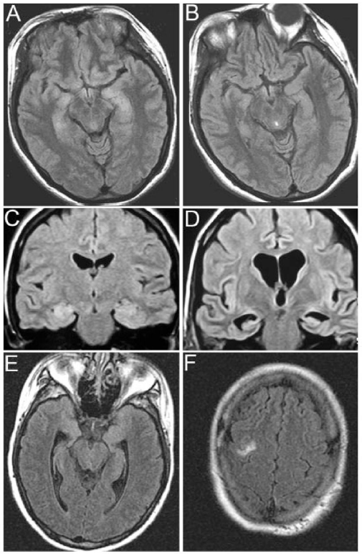
A, B ▶ (A) : MRI at symptom presentation
(B) : After partial clinical improvement and CSF normalization with immunotherapy
C, D ▶ (C) : MRI at symptom presentation
(D) : 4 months later. Developed rapidly progressive neurological deterioration that did not respond to immunotherapy.
E, F ▶ MRI at symptom presentation (E&F).
On FLAIR, mild hyperintensity in medial temporal lobe and right frontal cortex.
After immunotherapy and tumor resection,
the MRI was normalized.
Josep D et al. Paraneoplastic Anti–N-methyl-D-aspartate Receptor Encephalitis
Associated with Ovarian Teratoma Ann Neurol. 2007 January ; 61(1): 25–36.
Notes:
(B) : Tumor resection 이후 clinical improvement 및 MRI가 호전을 보임

Slide 23
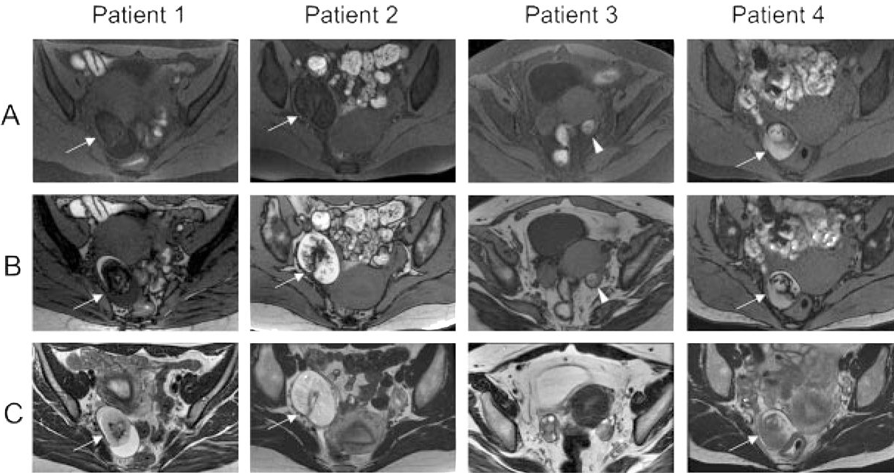
4th day
48th day
11th month
T. Lizuki et al. Anti-NMDA receptor encephalitis in Japan: Long-term outcome
without tumor removal Neurology. 2008 February 12; 70(7): 504–511
Notes:
(B) : Tumor resection 이후 clinical improvement 및 MRI가 호전을 보임

Slide 24
Management
Decrease antibody titer : NMDA receptor antagonist
MK801, Ketamine, phencyclidine
Immune modulating therapy – Inability of most commonly used trx.
Corticosteroids, Plasma exchange, IVIg – rapid & sustained control of the immune response within CNS
Long lasting dyskinesia : responded to propofol and midazolam
Conservative management : hypoventilation, autonomic instability
Josep D et al. Anti-NMDA-receptor encephalitis: case series and analysis of the effects of antibodies. Lancet Neurol. 2008;7:1091-98.
Notes:
Dyskinesia: Orolingual dyskinesias with athetoid postures, and evolved to intractable bizarre involuntary movements, some of which resembled complex partial seizure status epilepticus or a psychogenic disorder

Slide 25
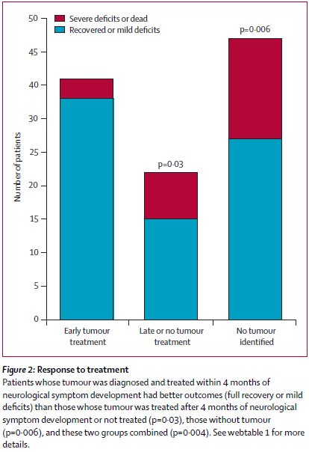
Josep D et al. Anti-NMDA-receptor encephalitis: case series and analysis of the effects of antibodies. Lancet Neurol. 2008;7:1091-98.

Slide 26
Prognosis
Better prognosis than most other paraneoplastic encephalitis.
Despite the severity of the disorder, 25% of the patients had severe deficits of died.
Resection of the tumor appeared important to attain final recovery or sustain the improvement that in some cases started soon after immunotherapy. (Corticosteroid, IVIg, Plasma exchange)
Josep D et al. Paraneoplastic Anti–N-methyl-D-aspartate Receptor Encephalitis
Associated with Ovarian Teratoma Ann Neurol. 2007 January ; 61(1): 25–36.

